Slide 1
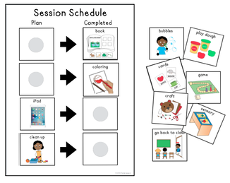
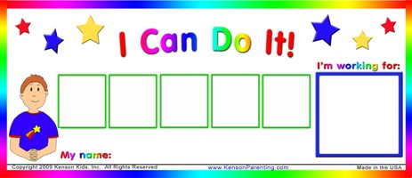
Antecedent Behavioral Strategies
Setting Students Up for Success

Slide 2
As teachers we can use identified antecedents and consequences to adapt how we work and interact with students to reduce challenging behaviors and teach skills
Use antecedent strategies decrease situation that
often lead to challenging behavior
Use antecedent strategies to teach skills as an
appropriate alternative to a challenging behavior

Slide 3
What can YOU control?
Language we use:
Verbal message
Non-verbal message
Consistency
Environment
Reinforcement
Choices and flexibility (within reason) Positioning

Slide 4
Language
Keep it positive: tell them what to do –NOT what NOT to do
Examples:
“Don’t climb on the chair”
“Stop biting your nails”
“You can’t have the iPad”

Slide 5
Language cont’d.
Be concise
Contingency review
(first ___, then ___)

Slide 6
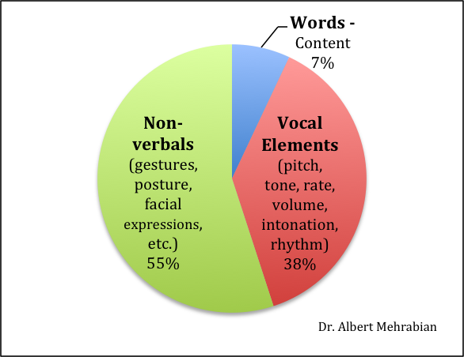
Verbal vs. Non-verbal
What you say and how you say it (or don’t say it)

Slide 7
Environment

Slide 8
Environment
KNOW the environment
Free of clutter/distractions
Intentional
Preferential seating
Use of visuals/reminders
Safe
Accessible

Slide 9
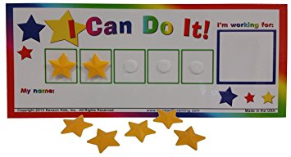
Reinforcement
Student specific reinforcement schedules
Reinforce appropriate behaviors that happen naturally in environment
Get excited!!

Slide 10
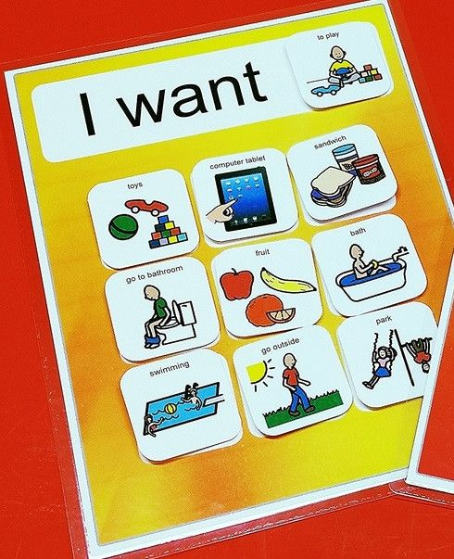
Choices and flexibility
Provide choices whenever possible
Remain flexible within reason
Alternate choices
Use visuals

Slide 11
Teaching
Functional communication
Teaching alternatives
Problem solving
Replacement behaviors
Calling out
Whining
Swiping materials

Slide 12
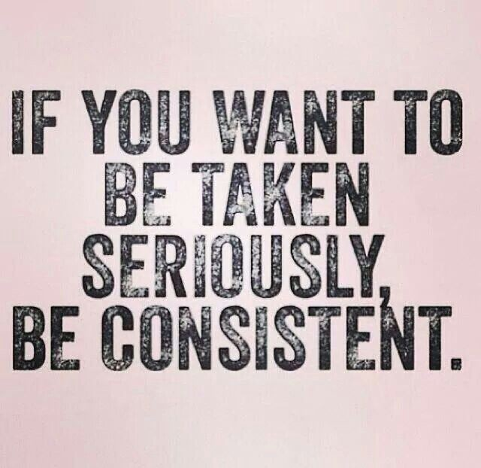
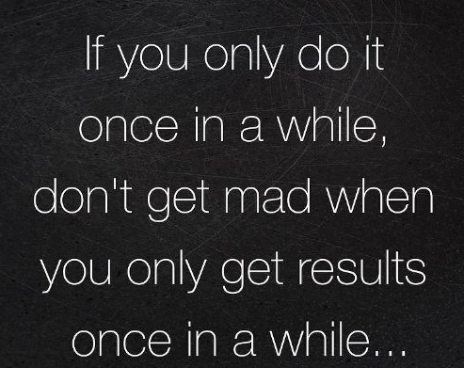
Consistency

